Slide 1
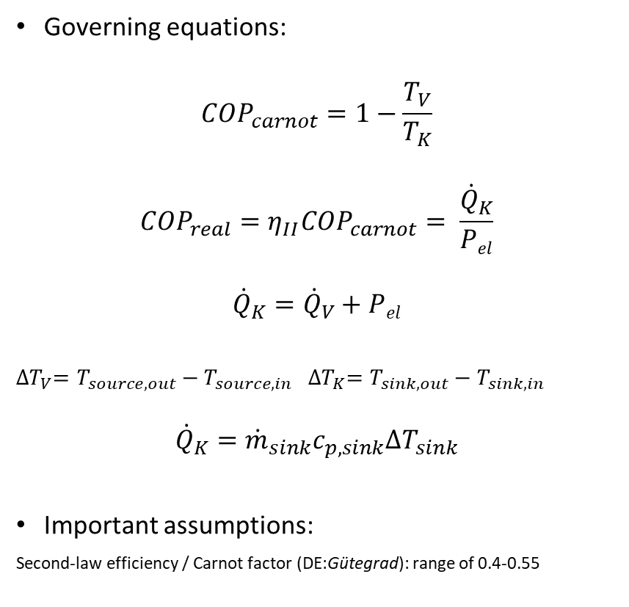
Component: Heat pump Conceptual diagram, equations, assumptions
c_{p,source}
P_{el}
ṁ_{source}
T_{source, in}
T_{sink, out}
Governing equations:
$${COP}_{carnot}=1−\frac{T_{V}}{T_{K}}$$
$${COP}_{real}=η_{II}{COP}_{carnot}= \frac{{\dot{Q}}_{K}}{Pel}$$
$${\dot{Q}}_{K}={\dot{Q}}_{V}+Pel$$
${∆T}_{V}=T_{source, out}−T_{source, in}$ ${∆T}_{K}=T_{sink, out}−T_{sink, in}$
$${\dot{Q}}_{K}={\dot{m}}_{sink}c_{p, sink}{∆T}_{sink}$$
Important assumptions:
Second-law efficiency / Carnot factor (DE:Gütegrad): range of 0.4-0.55
Cond.
T_{K}
Evap.
T_{v}
Q̇_{v}
Q̇_{K}
T_{source, out}
T_{sink, in}
ṁ_{sink}
c_{p,sink}

Slide 2
Component: Heat pump Model notes
P_{el}
T_{source, in}
T_{sink, out}
Governing equations:
Important assumptions:
Second-law efficiency / Carnot factor (DE:Gütegrad): range of 0.4-0.55
Cond.
T_{K}
Evap.
T_{v}
Q_{v}
Q_{K}
T_{source, out}
T_{sink, in}

Slide 3
Component: Heat pump Computation sequence
Governing equations:
Important assumptions:

